Slide 1

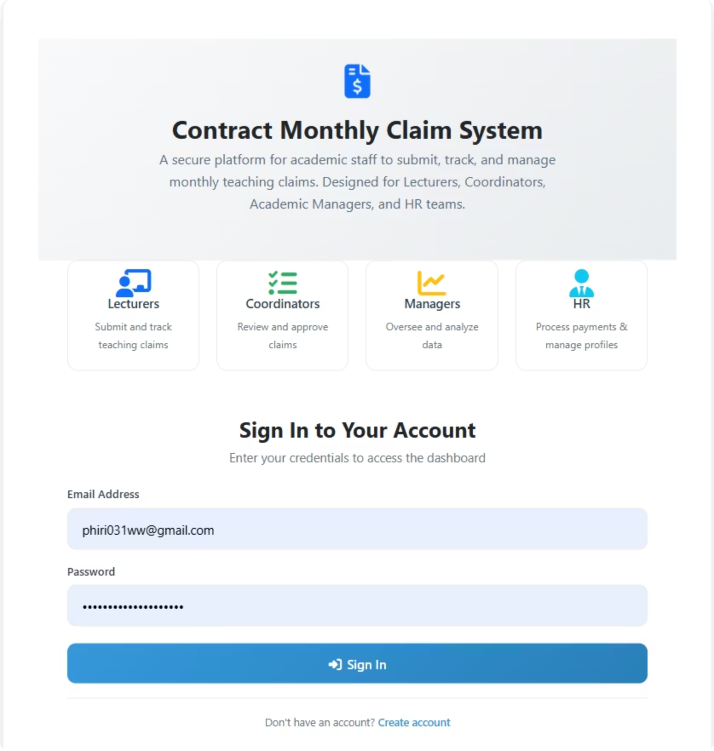
Contract Monthly Claim System (CMCS)
Streamlining monthly lecturer claims end-to-end with speed, accuracy, transparency, and auditability

Slide 2

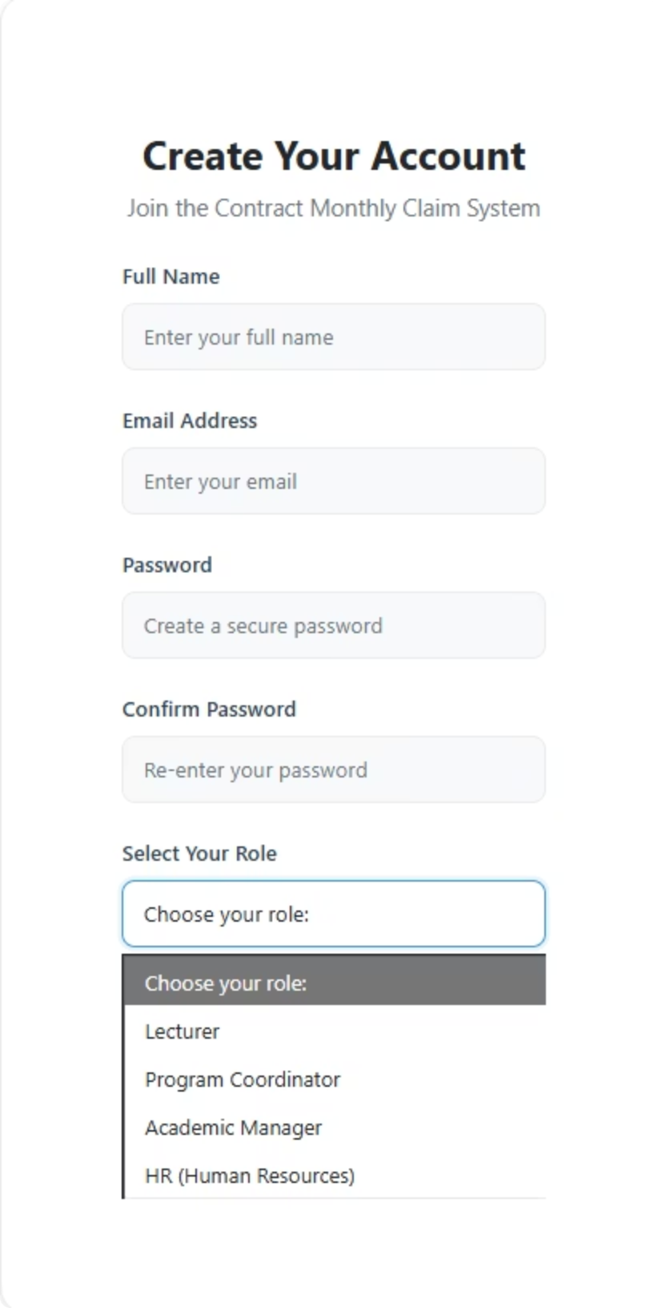

Roles & Access Model
Lecturer
Manages course content, submits claims, accesses role-based dashboards and permissions with [Authorize] and least-privilege principles.
Program Coordinator
Reviews and approves claims, monitors program budgets, accesses role-based dashboards and permissions with [Authorize] and least-privilege principles.
Academic Manager
Oversees academic operations, strategic planning, accesses role-based dashboards and permissions with [Authorize] and least-privilege principles.
HR
Handles staff records, payroll integration, accesses role-based dashboards and permissions with [Authorize] and least-privilege principles.

Slide 3
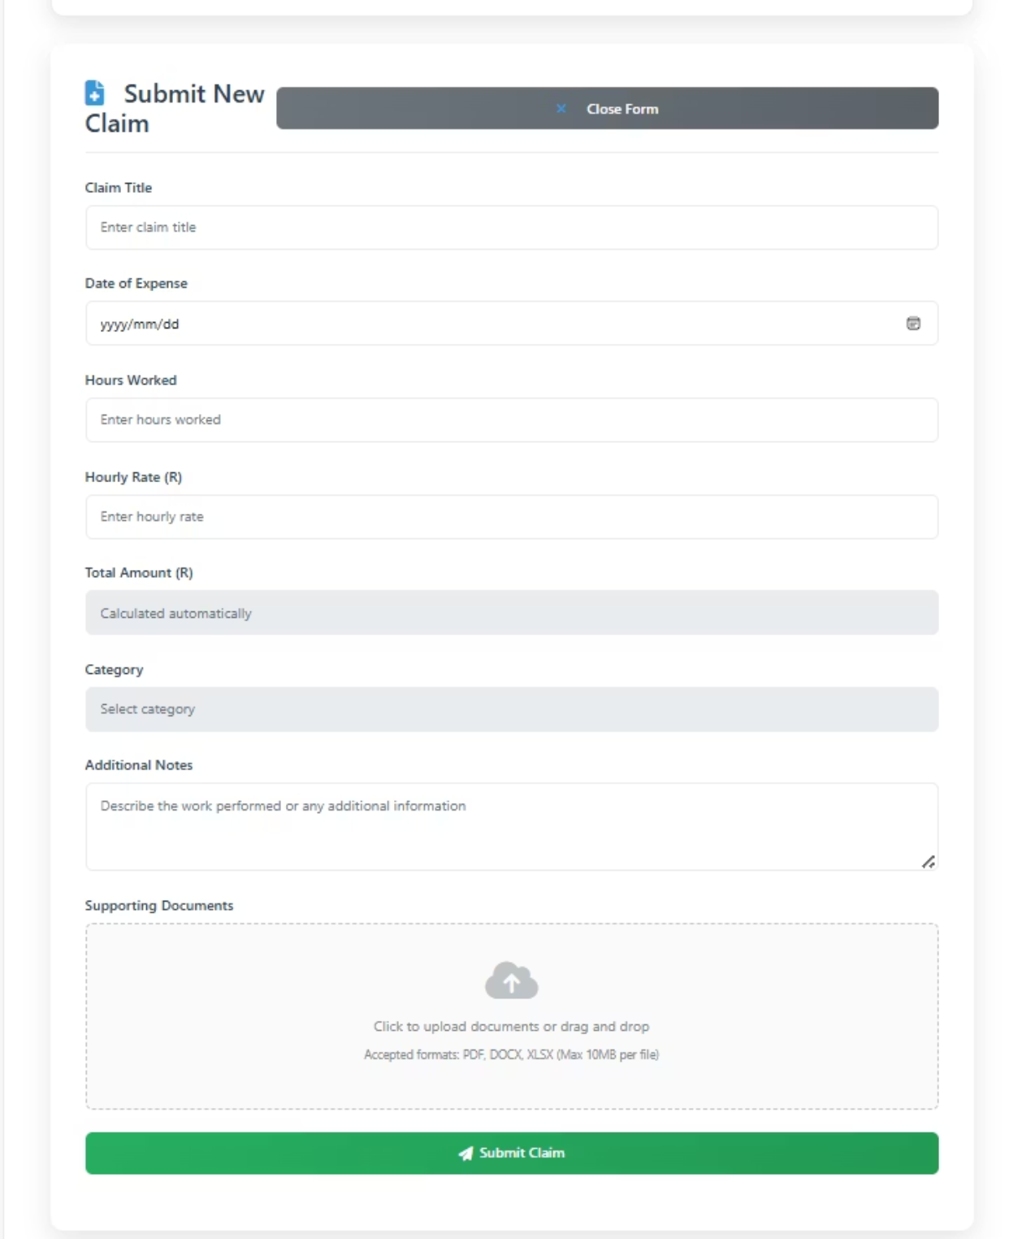
Lecturer Experience — Submit Claim
Lecturers can easily submit claims with the following features:
Title, Date, Category, Hours, Rate, Notes
Multiple attachments (PDF/DOCX/XLSX)
Auto total calculation + validations
Real-time status on LectureDashboard

Slide 4

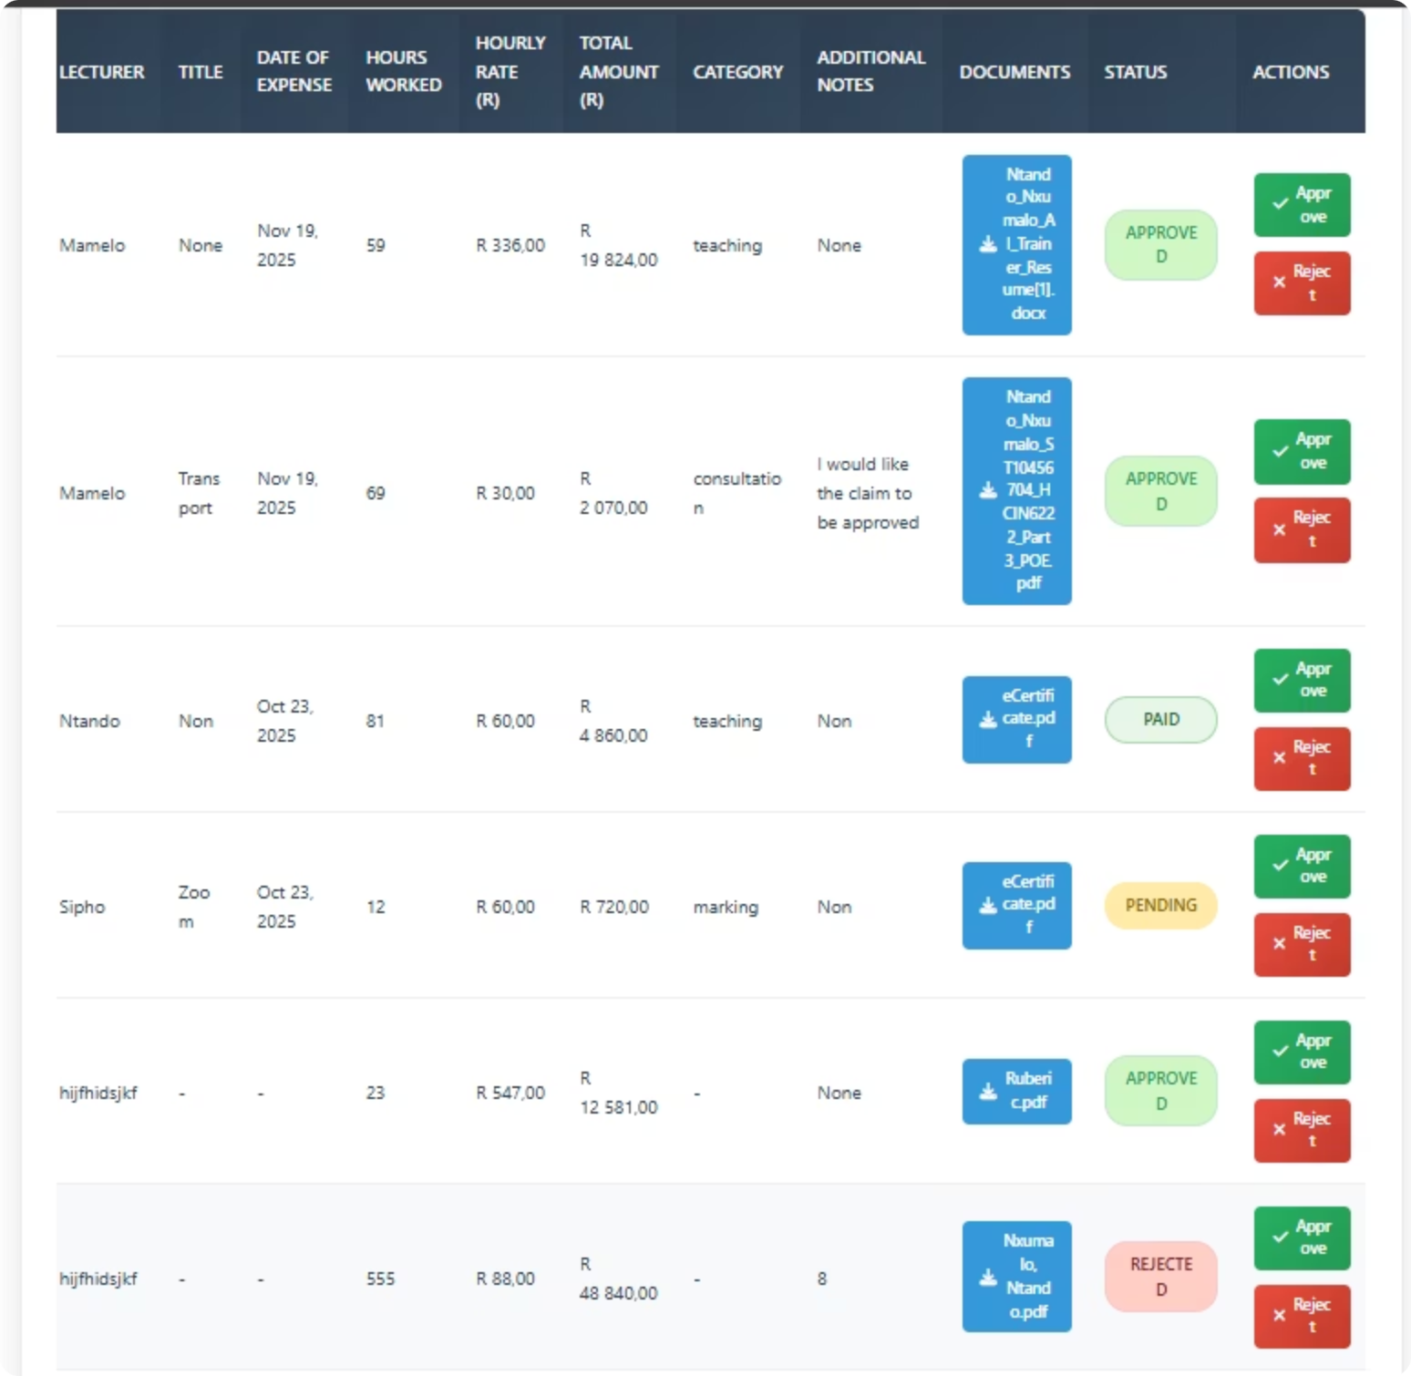
Document Handling & Security
ClaimDocument Model
Secure Downloads
Multiple files per claim, metadata
Owner/coordinator/manager/HR access
Access Control
Controller level checks

Slide 5
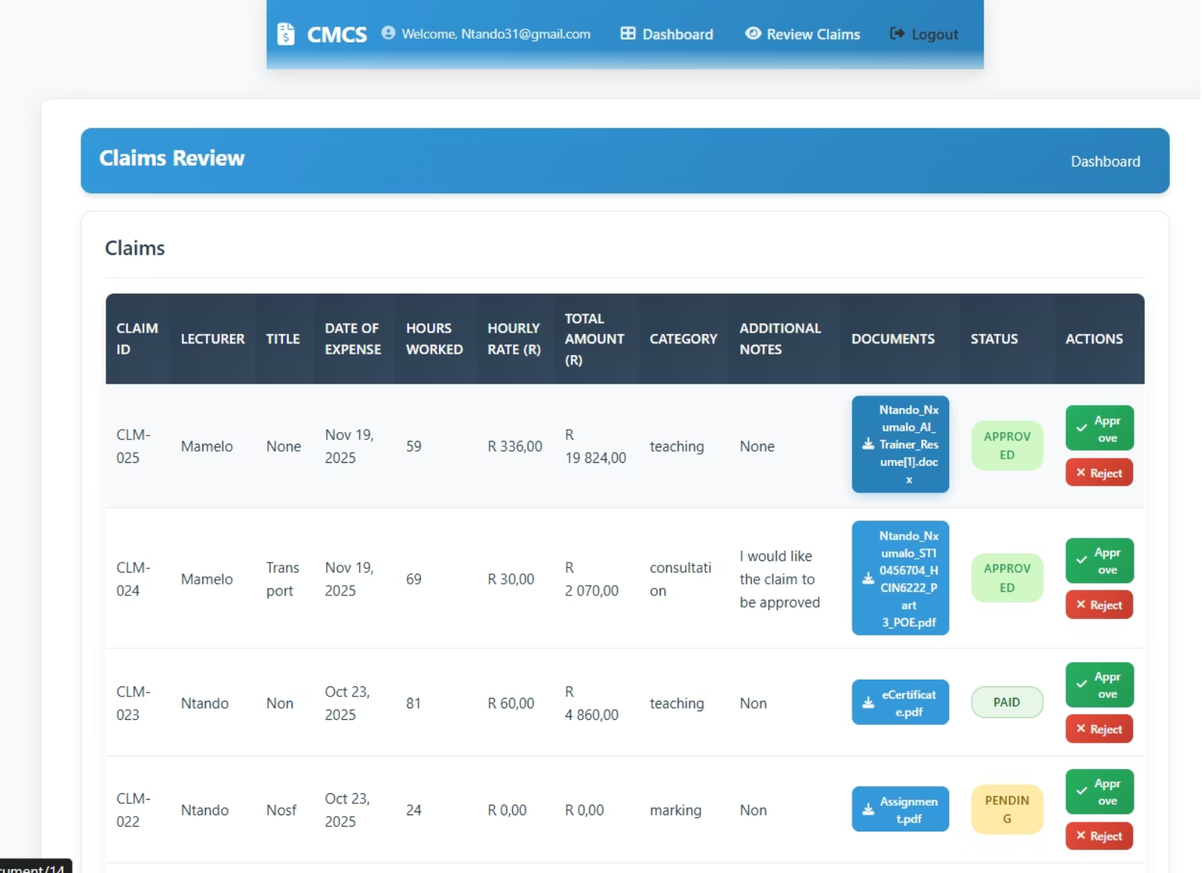
Workflow — Approve / Reject
Coordinator/Manager dashboards
Approve/Reject actions with instant updates
Partial row refresh for snappy UX

Slide 6

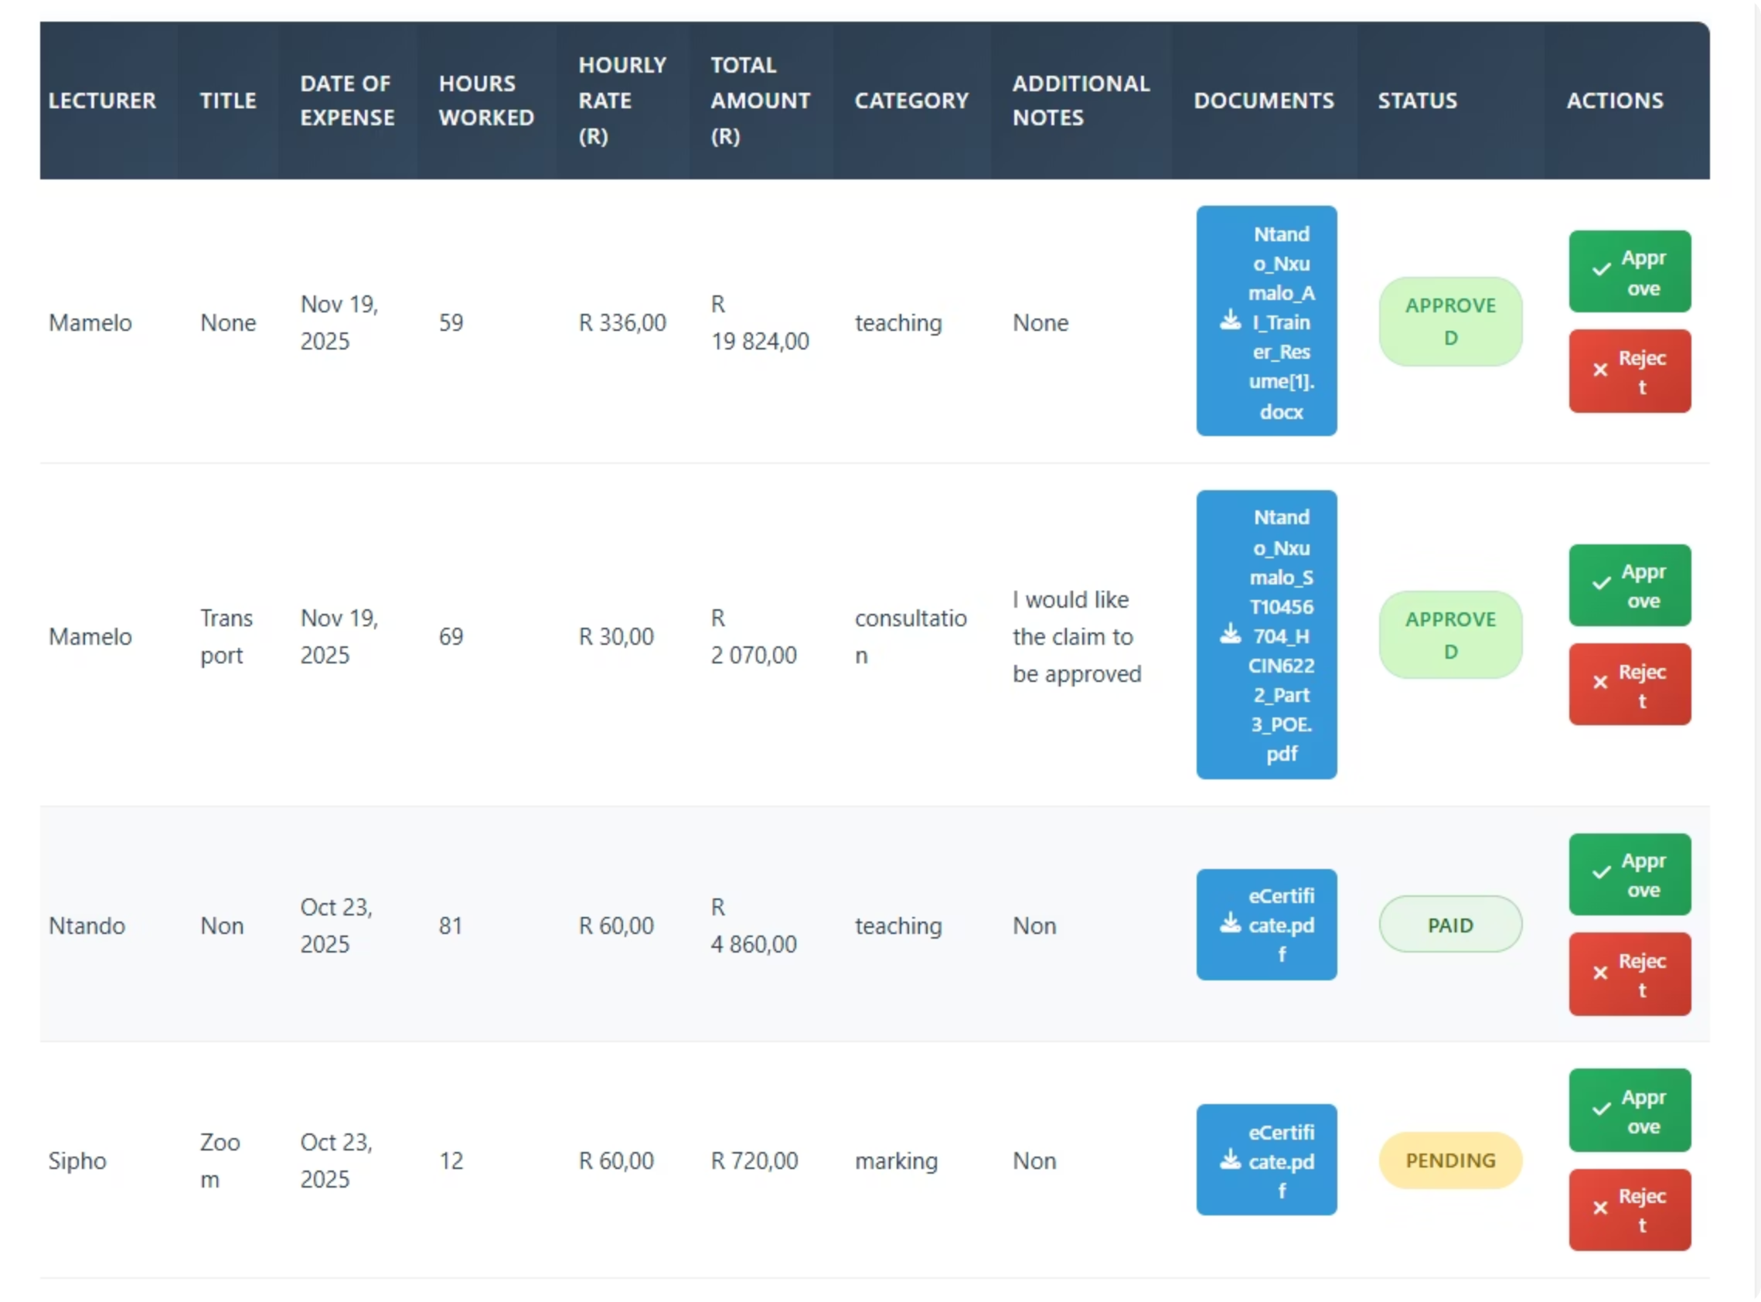



Real-time Collaboration (SignalR)
Experience live updates without page reloads, fostering seamless collaboration across all roles
Live Status Changes
No reload needed
SignalR Groups
Coordinators, HR, per-user
Controller Broadcast
On submit/approve/reject

Slide 7
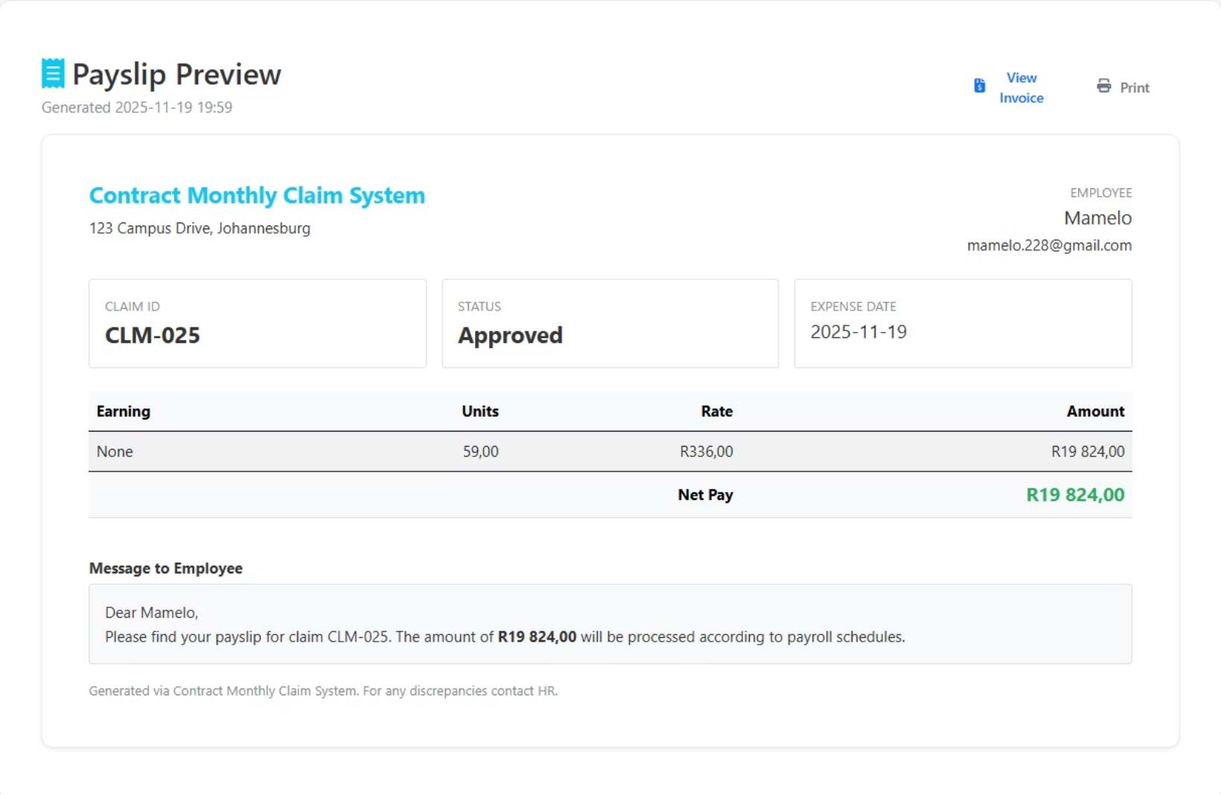
HR Dashboard & Payment Processing
Approved claims queue with totals
Mark as Paid AJAX JSON
Payslip preview/save
Lecturer profile updates

Slide 8

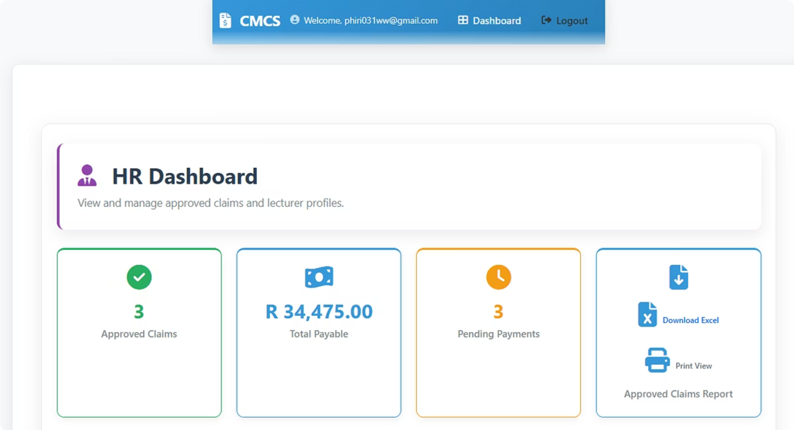
Reporting & Exports
Generate comprehensive reports and export data in various formats for analysis and record-keeping
Excel Export
Data export via ClosedXML
PDF Reports
Generate reports using QuestPDF
Printable Reports
Approved Claims Report

Slide 9

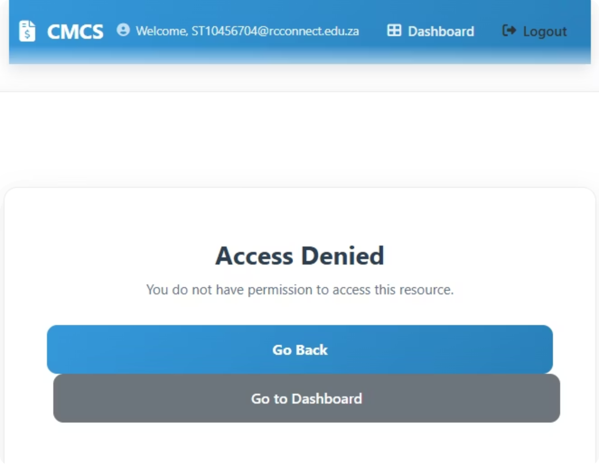
Security & Authorization
Robust security measures ensure data integrity and user access control
Identity Roles
Defined in Program.cs
Authorization
Using [Authorize] attributes
Document Access
Strict restrictions

Slide 10

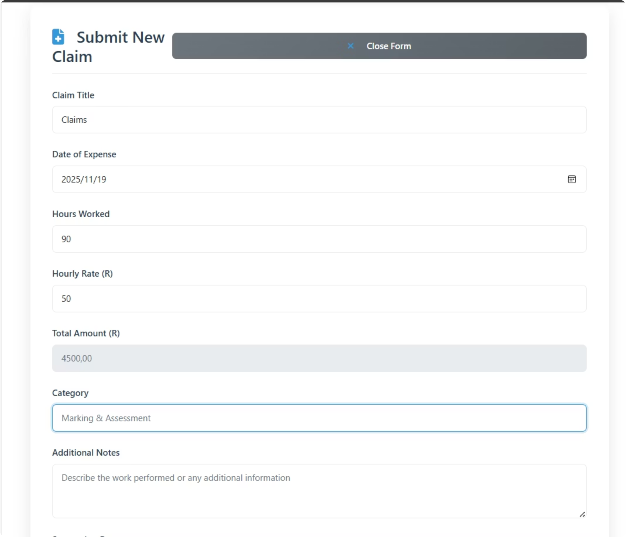
Data Integrity & Rounding Rules
Totals Logic
MidpointRounding.AwayFromZero for consistent calculations
Financial Correctness
Ensures accurate monetary calculations across all transactions

Slide 11

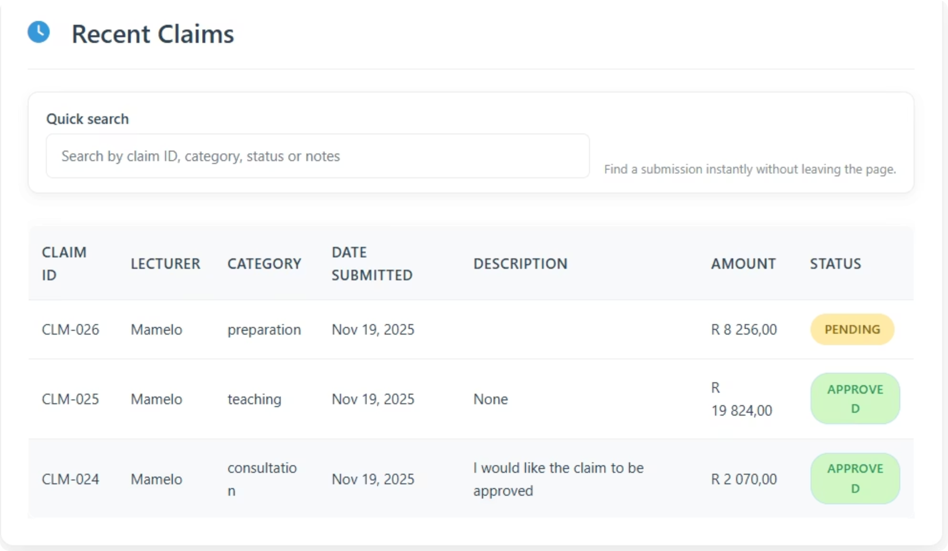
Audit & Persistence
Claim Fields
Relational Data
Title, DateOfExpense, Category, Total, Status, CreatedAt
Claim, ClaimDocument, Lecturer models
Schema Evolution
Migrations and database versioning

Slide 12

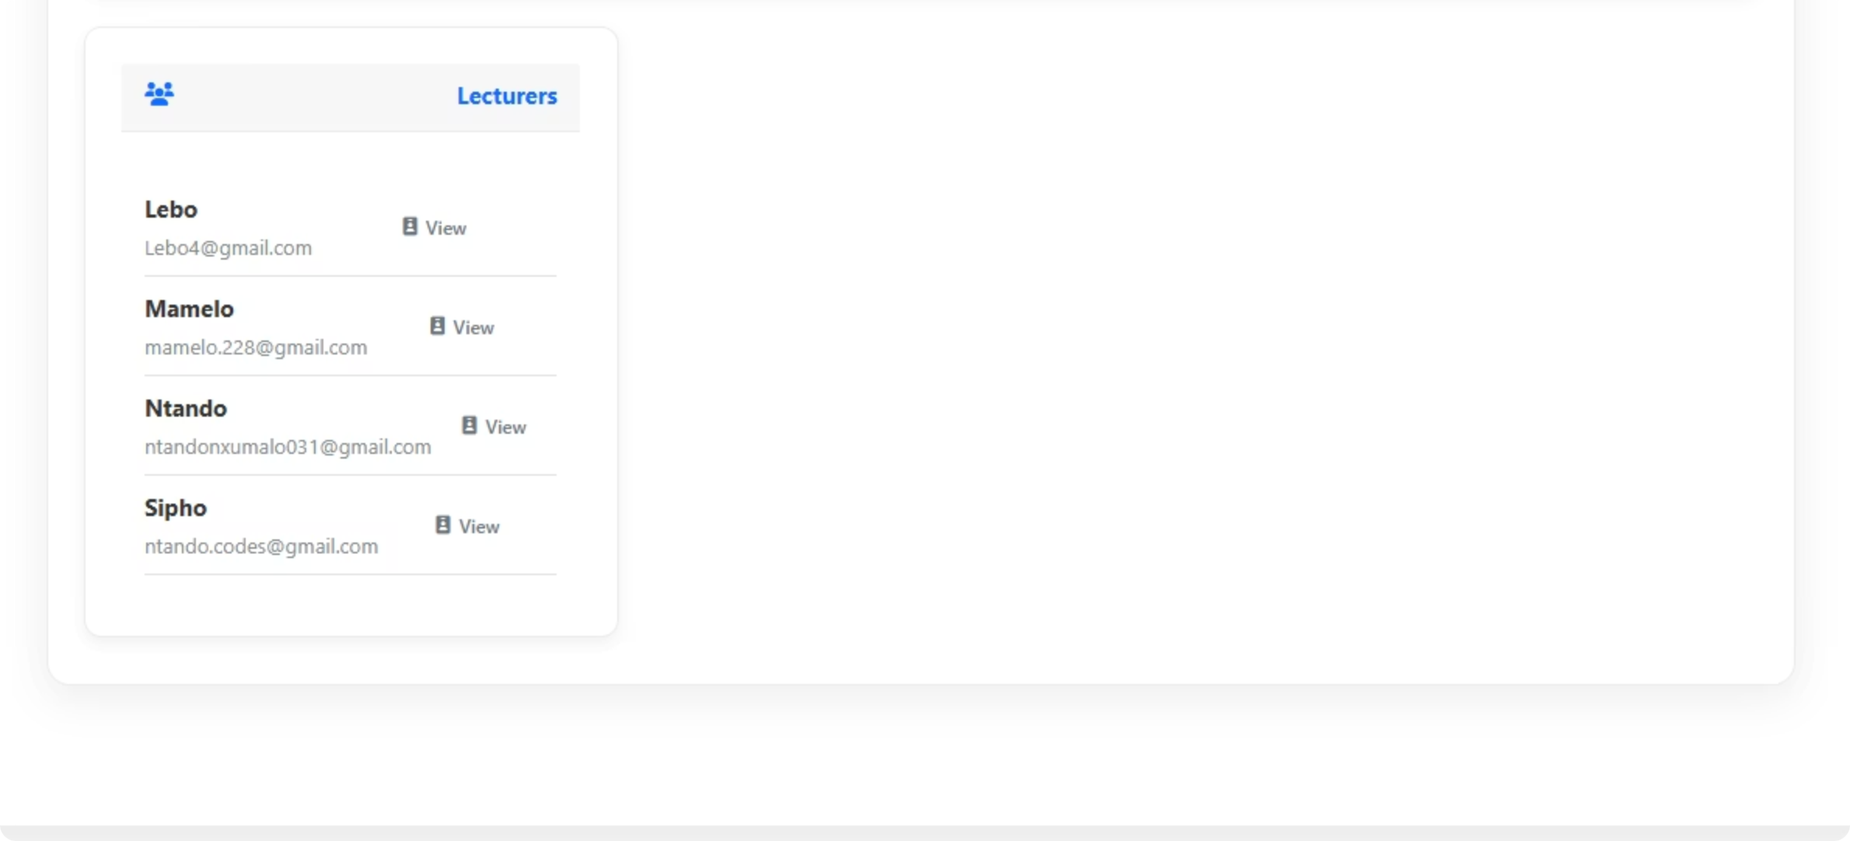
QA & Testing
xUnit Tests
Test Coverage
Comprehensive unit testing framework
Totals, multi-doc handling, access control
Reliability
Across approval/rejection and downloads

Slide 13

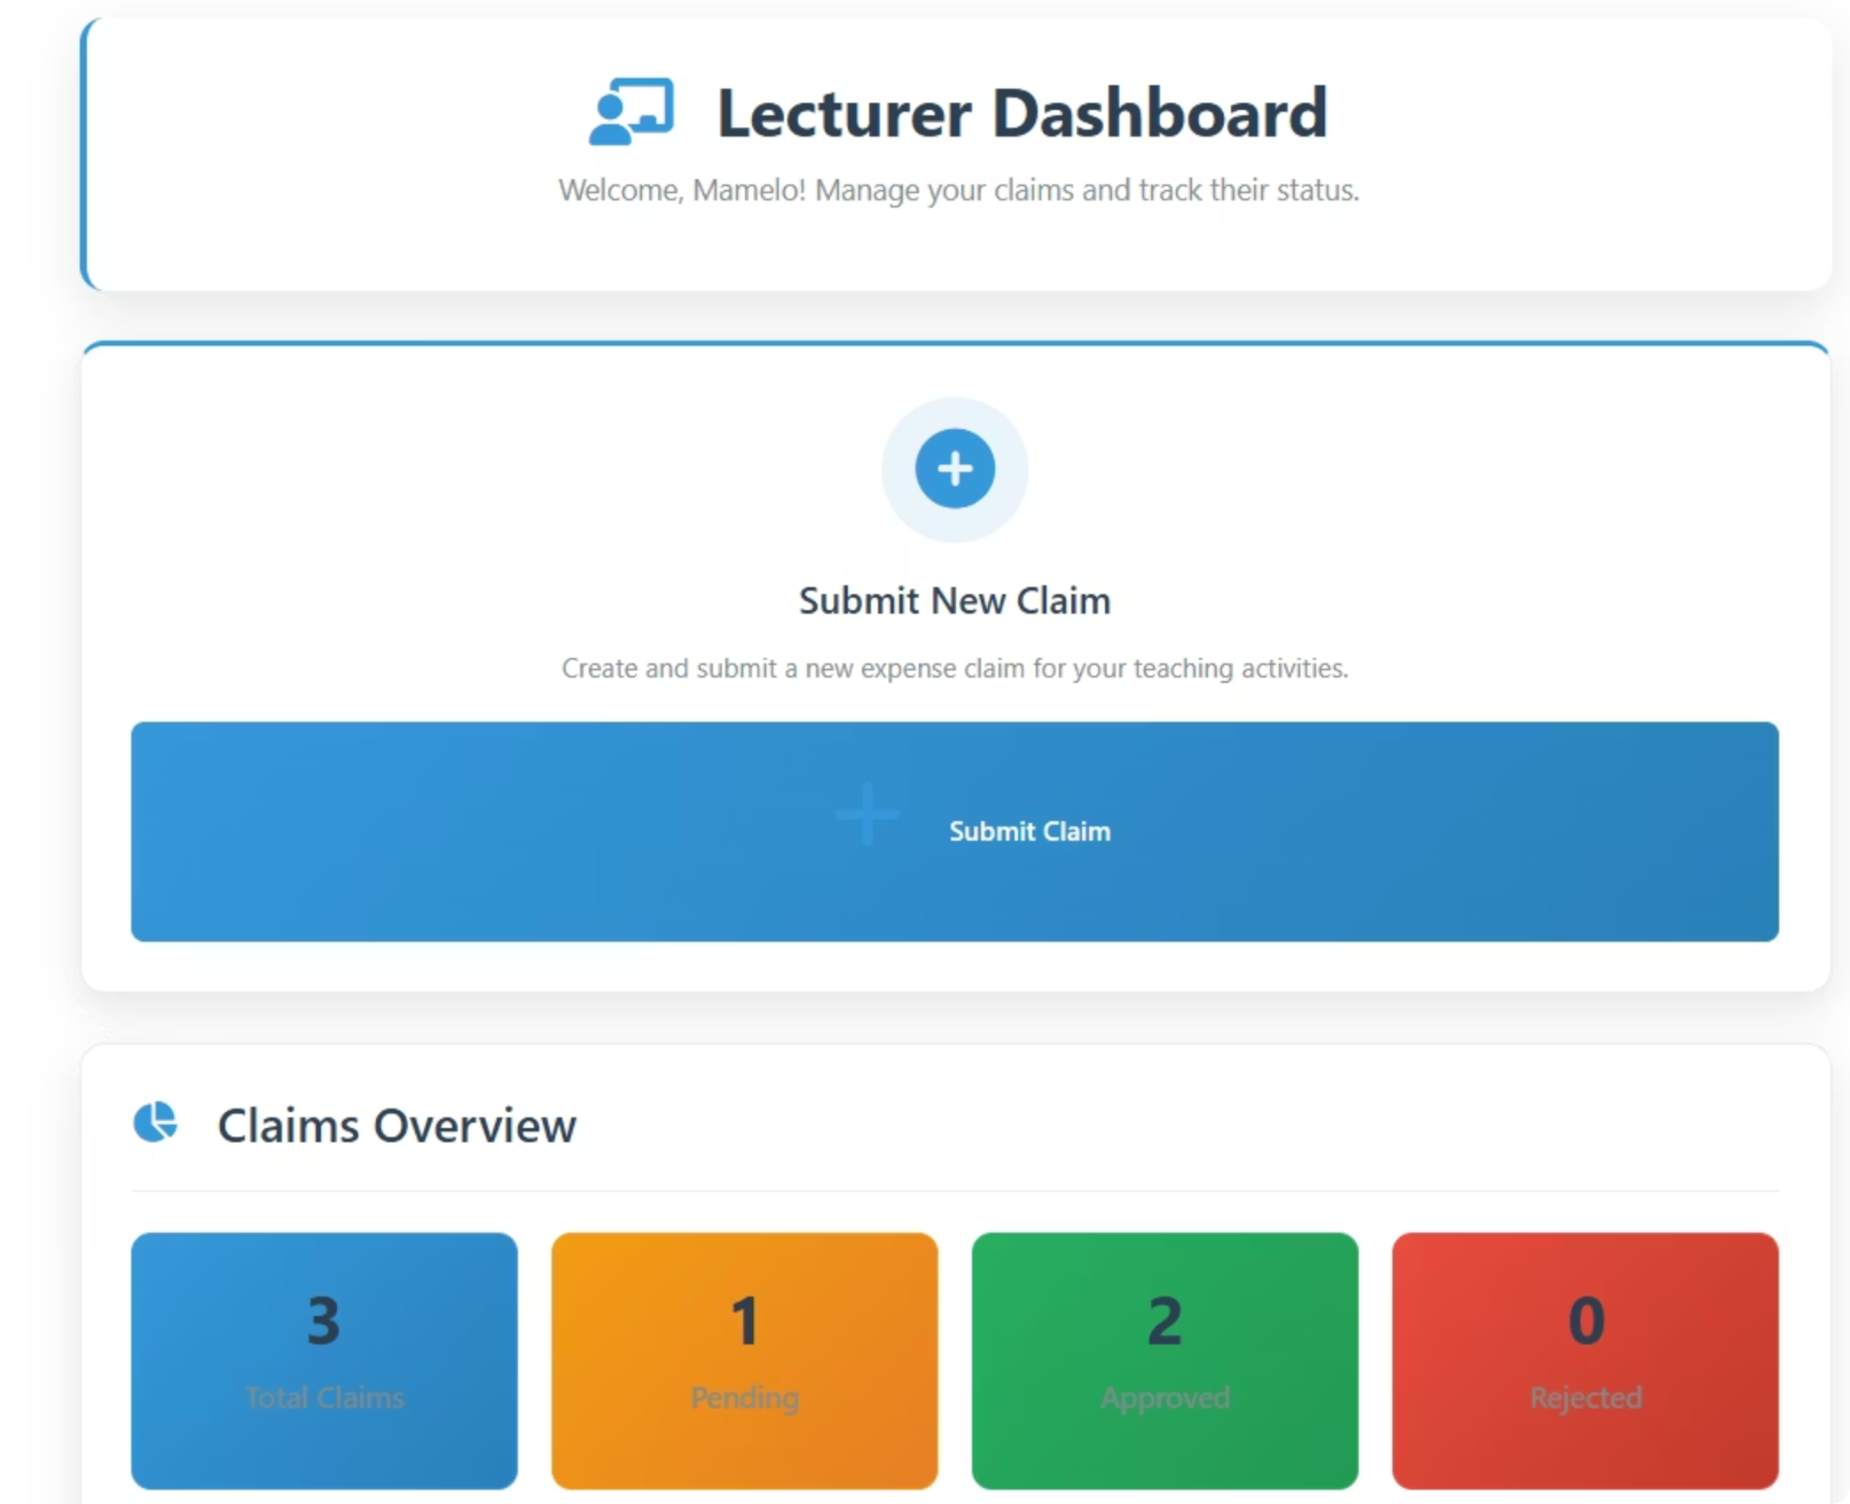
UX Details & Accessibility
Dashboard Features
Modern Interface
Search/filter and status badges
Contemporary navbar design
Notifications
Responsive Design
Real-time user feedback
Mobile and desktop optimized

Slide 14
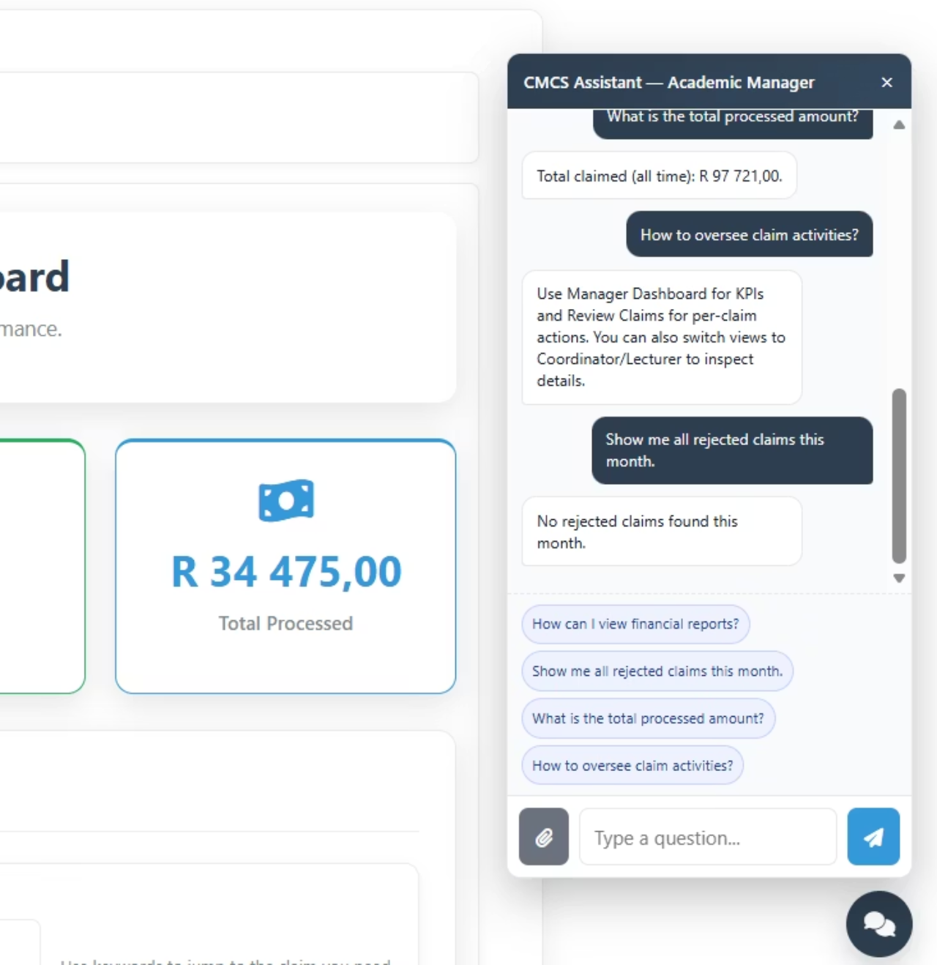
AI Chatbot — Q&A and PDF Analysis
Widget embedded on dashboards Shared/_Chatbot.cshtml
Endpoint POST /Chat/Ask for role-aware queries
PDF invoice total extraction PdfPig text parsing
Claims analytics by timeframe and role
Productivity boost: quick insights, less manual checking

Slide 15
Live Demo Plan & Roadmap
Demo Flow
Lecturer submits
Coordinator approves
Manager reviews KPIs
Lecturer submits their monthly claim with all required details and attachments.
Program Coordinator reviews the claim and approves it.
Academic Manager reviews key performance indicators related to claims.
HR exports & marks paid
Chatbot extracts total from uploaded invoice
HR department exports approved claims and marks them as paid.
AI Chatbot automatically extracts the total amount from an uploaded invoice.
Roadmap
OCR for scanned PDFs
Non-PDF parsing
Advanced analytics
Structured logging
Payroll integration

